Slide 1
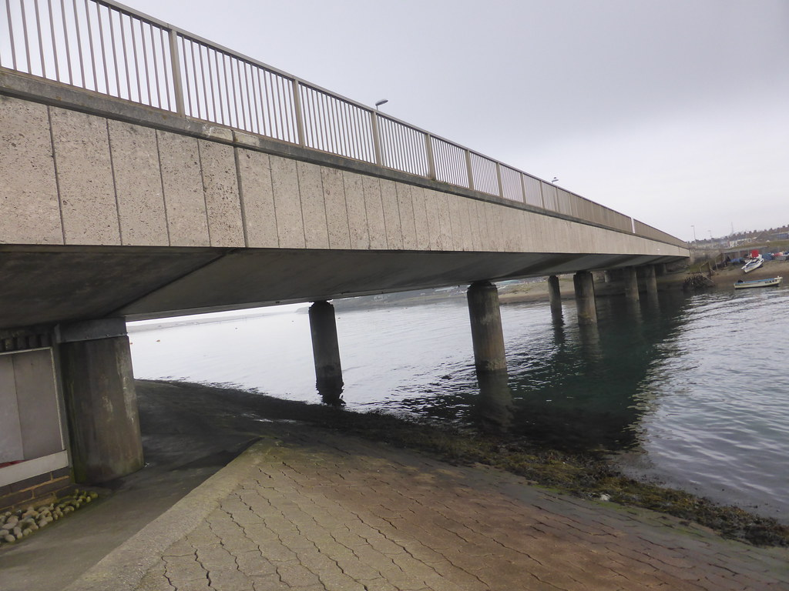
NDSAC
Ferrybridge Project
2022
Gwyn James
Graham Brown
Giles Adams

Slide 2
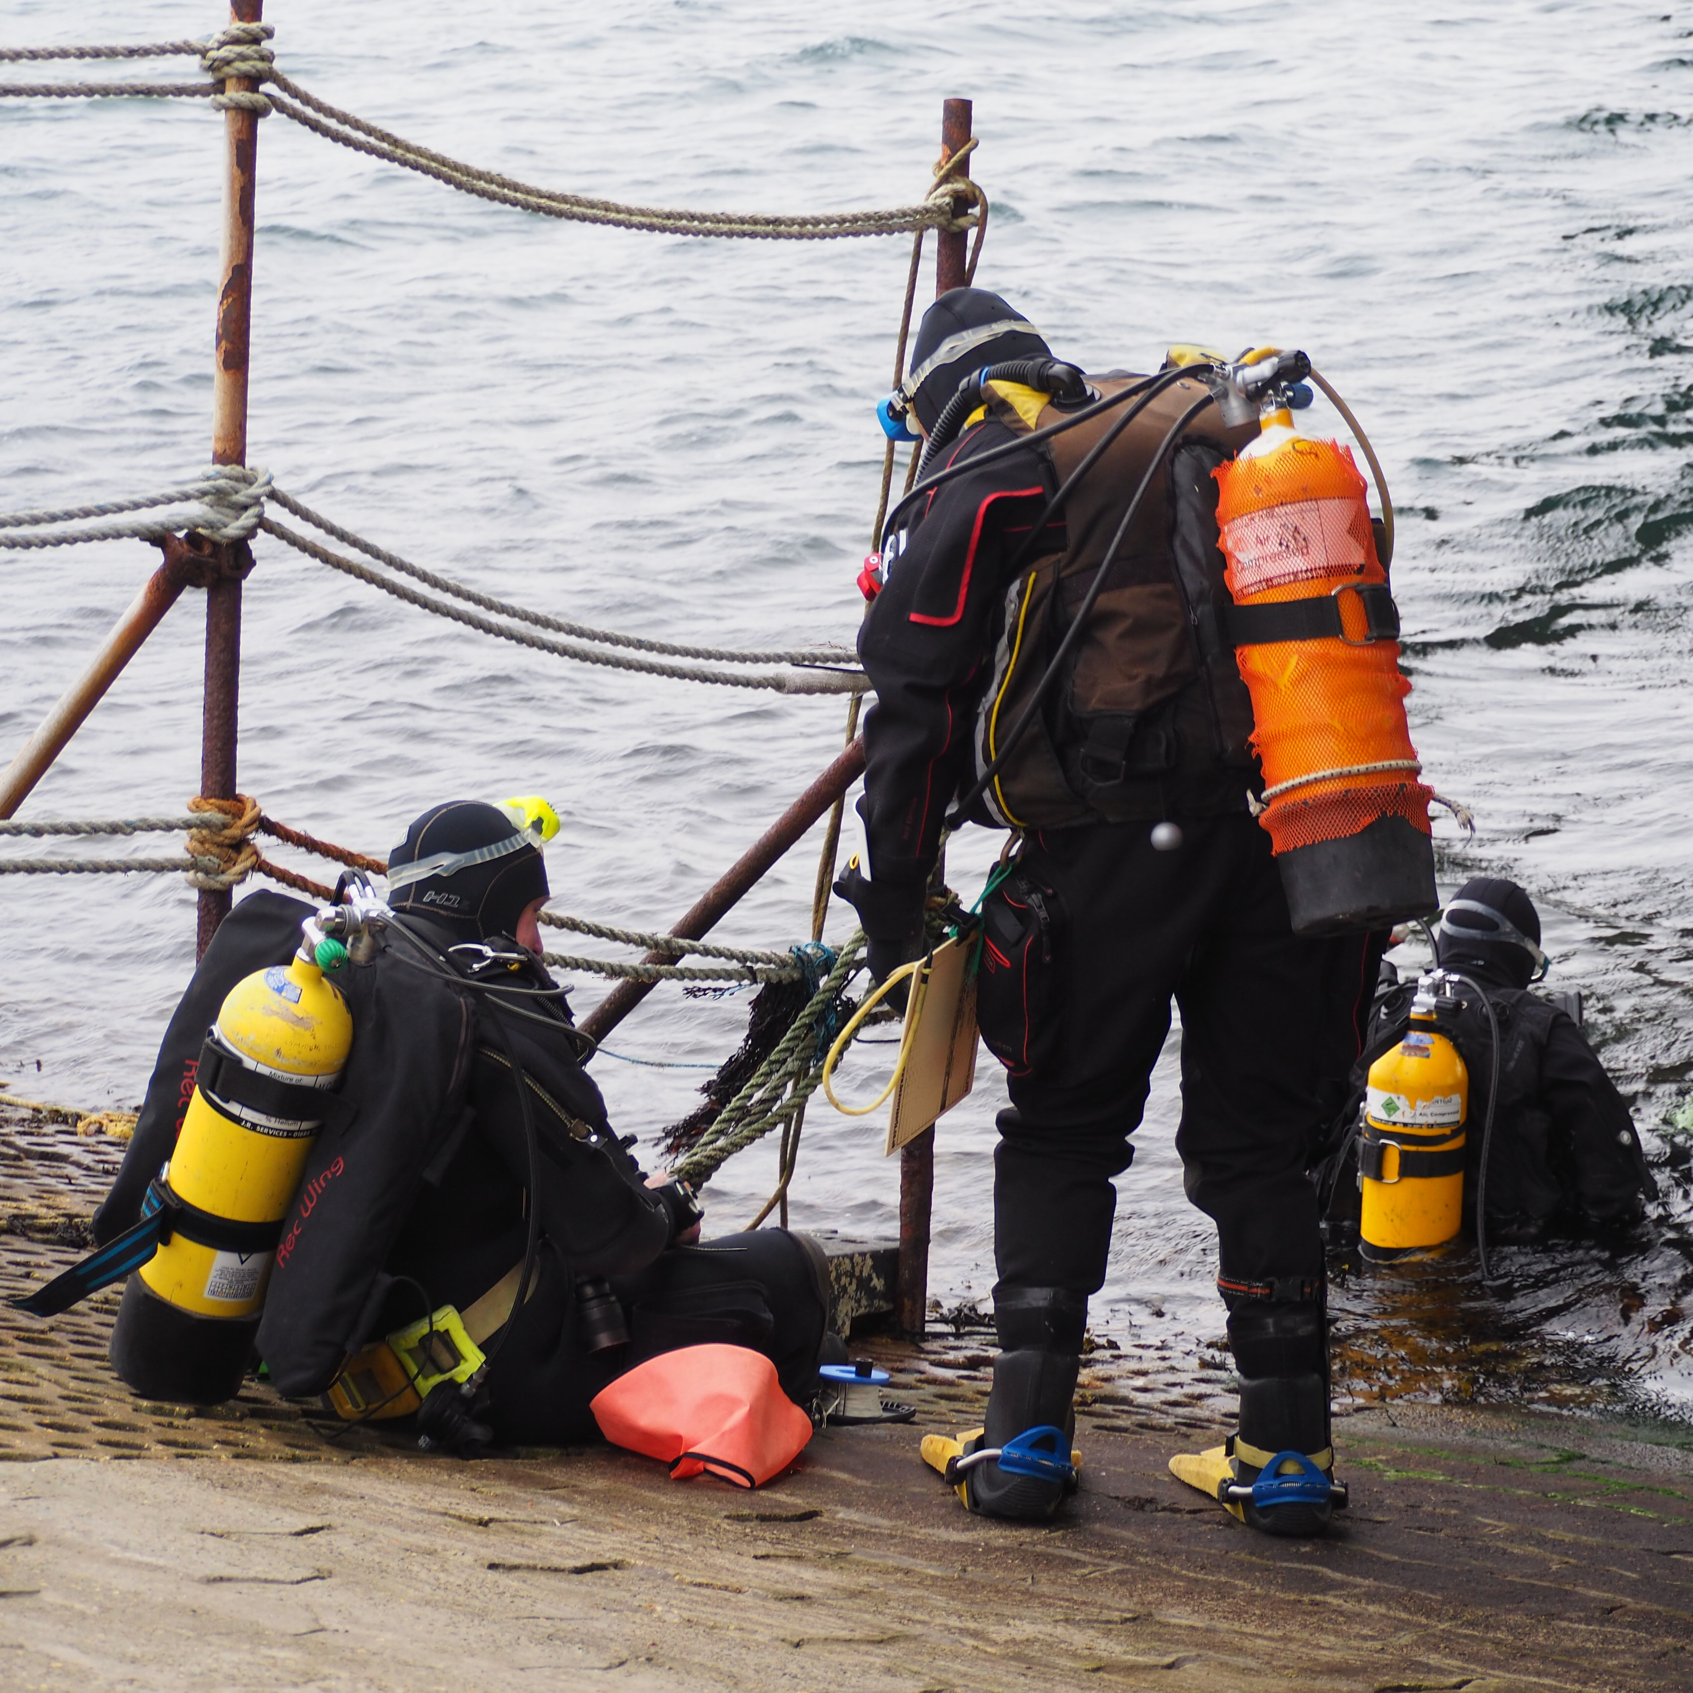
Aims and actions
To conduct an informal marine life survey of the Ferrybridge outflow of the Fleet Lagoon recording species and environment over time.
Actions:
Information gathering about the site – geology, site management, development and use, historic background.
Information referencing the adjoining Fleet Lagoon and Portland harbour.
Mapping the dive site and recording any changes.
Collecting data on species including photographs.

Slide 3
Managing the project
Who can take part:
Small groups of NDSAC Diving members - Ocean Diver and above.
Recording findings.
Inform Graham Brown, Giles Adams or the project administrator when diving is planned and return information to them.
Dive logs with duration, depth and conditions of individual dives.
General descriptions of the seabed to provide base and record changes.
Photos and video
Species identification list material (Seasearch record form can be used to record)

Slide 4
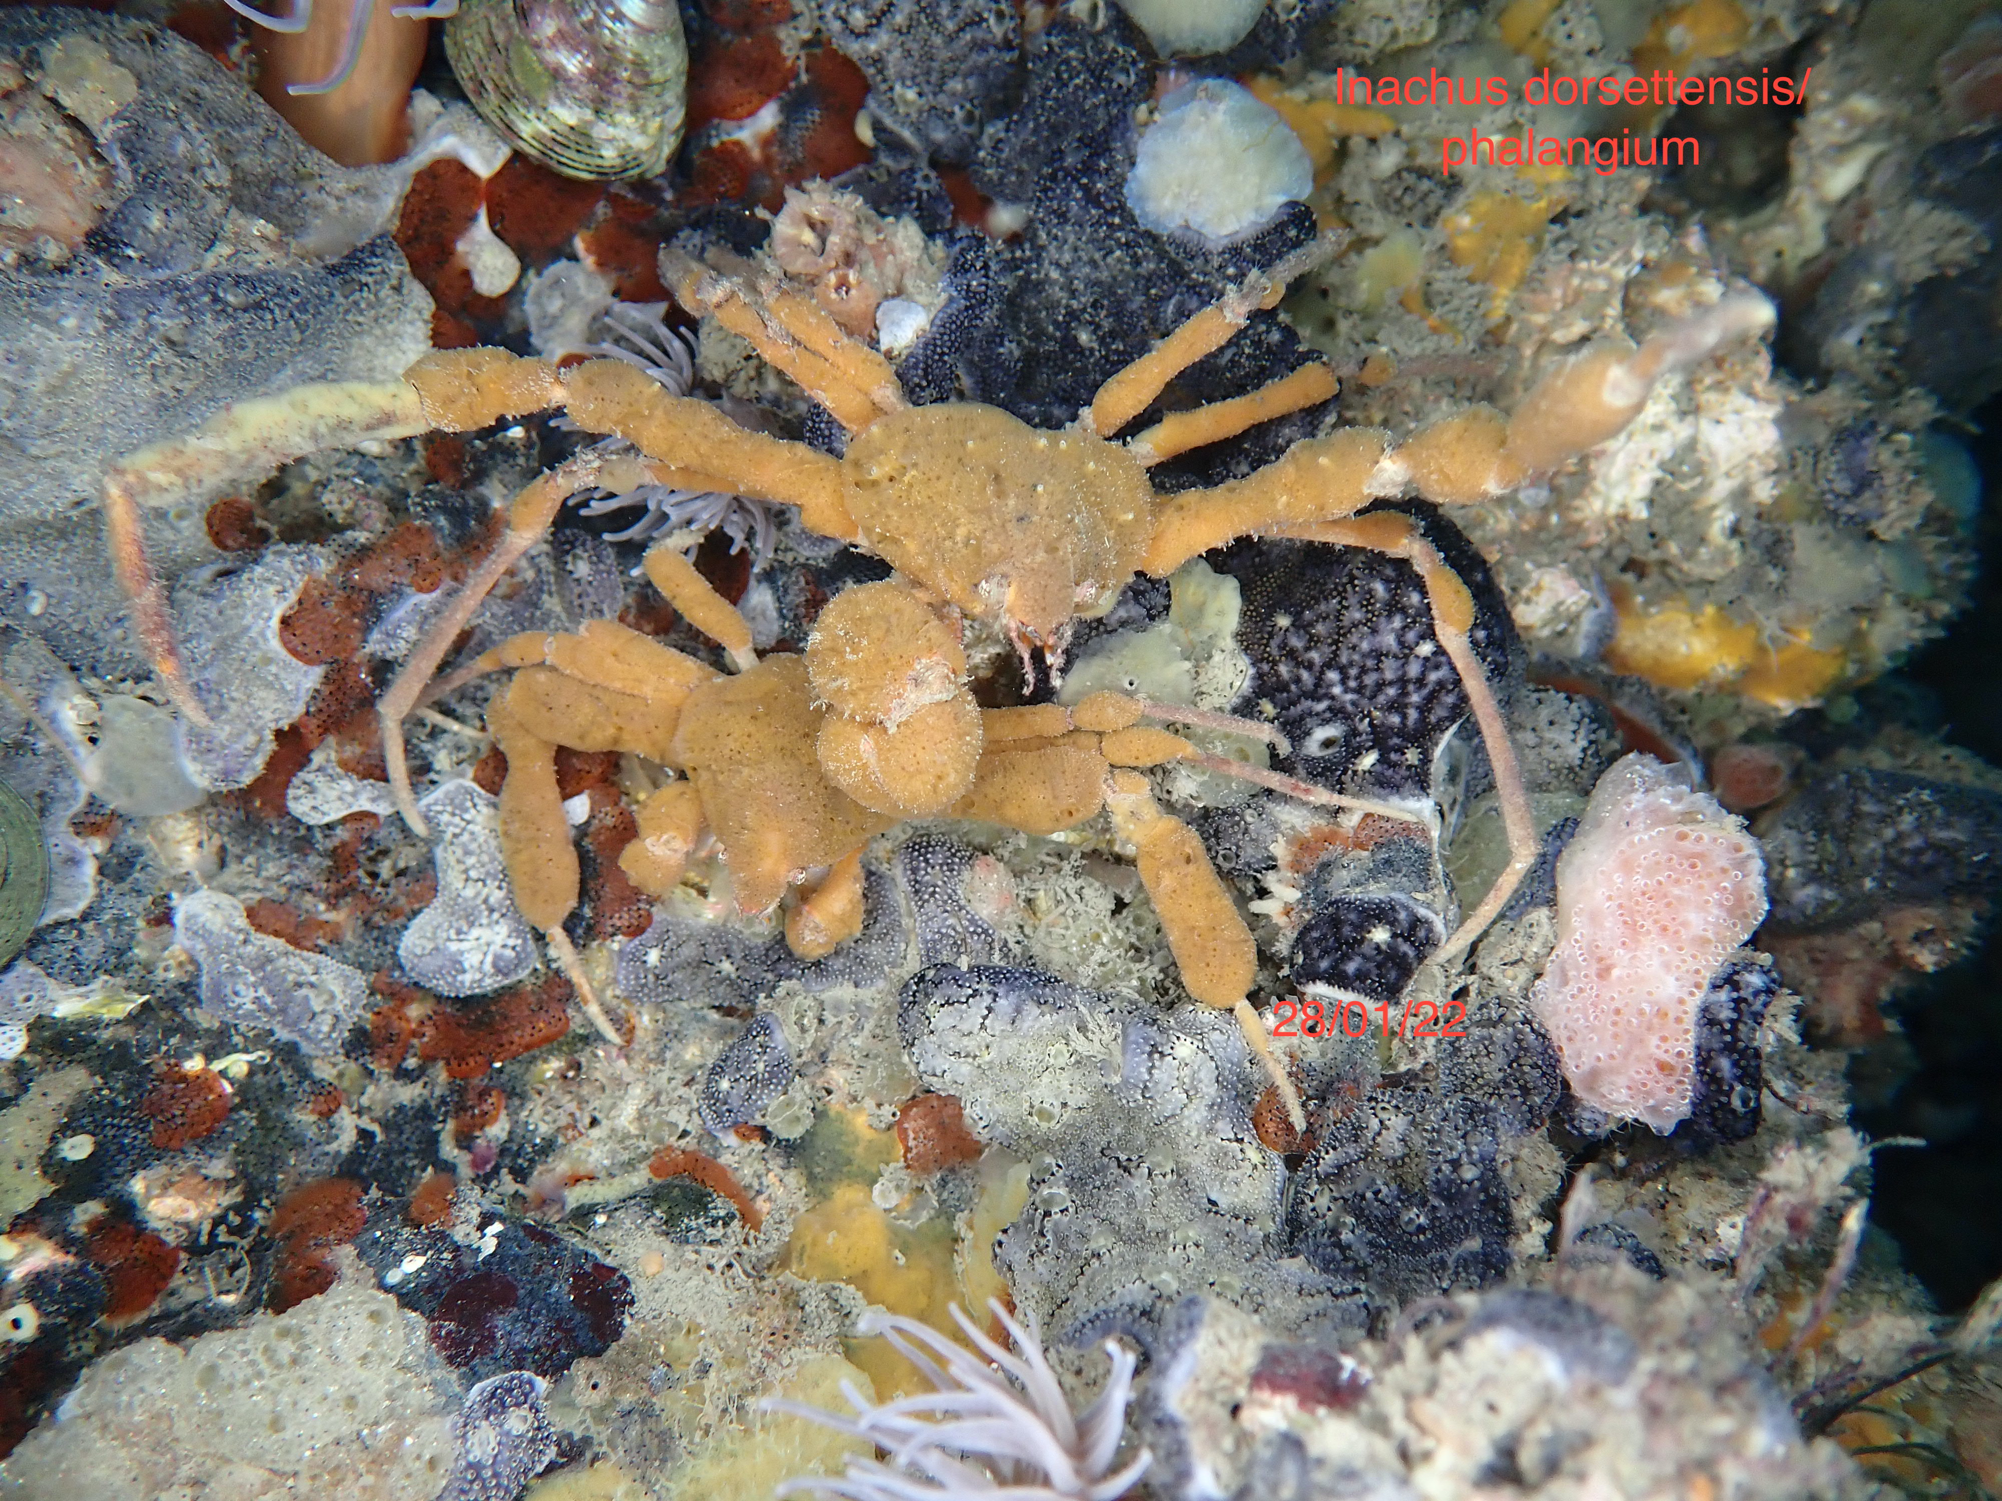
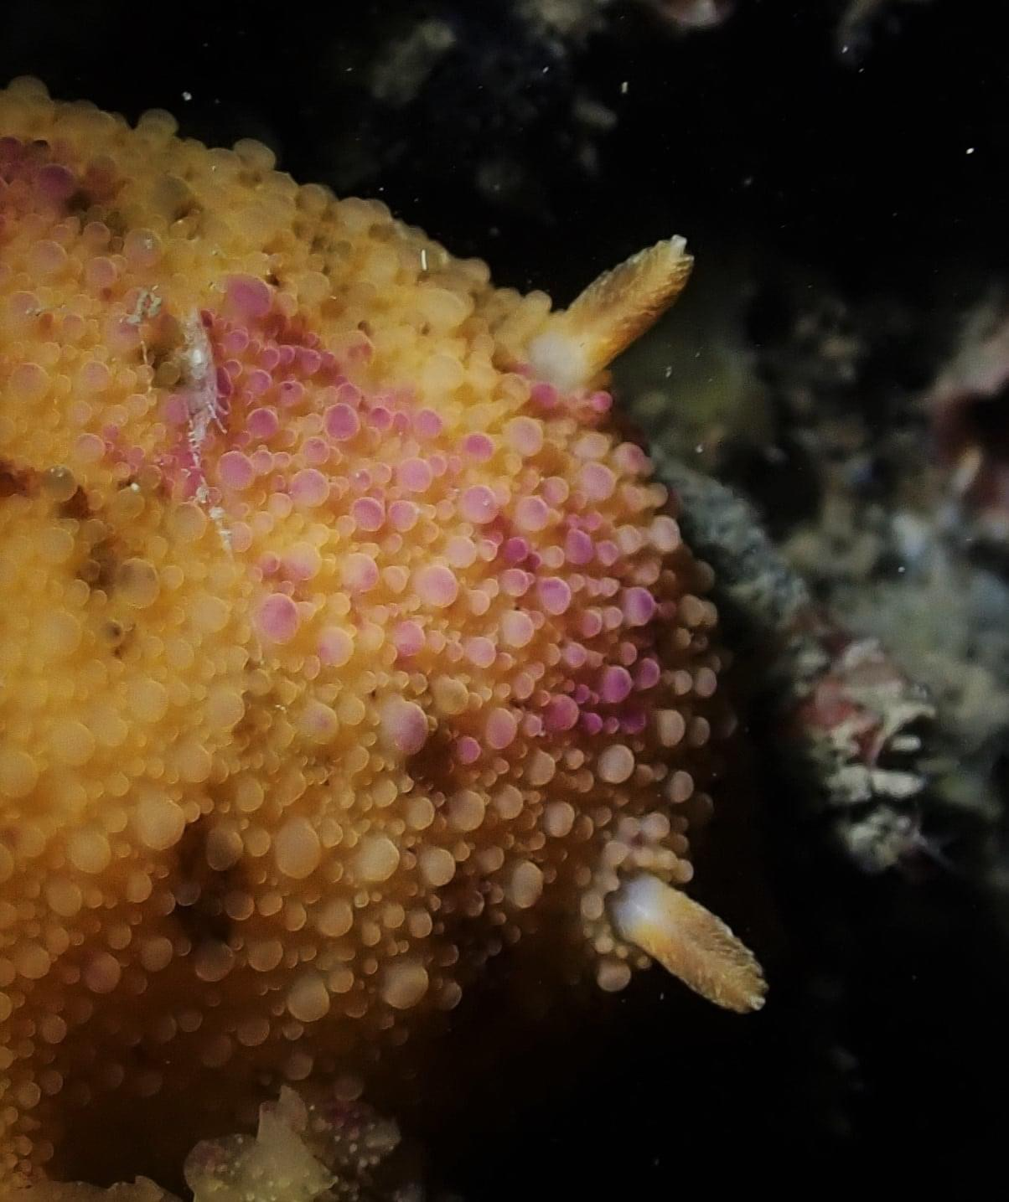
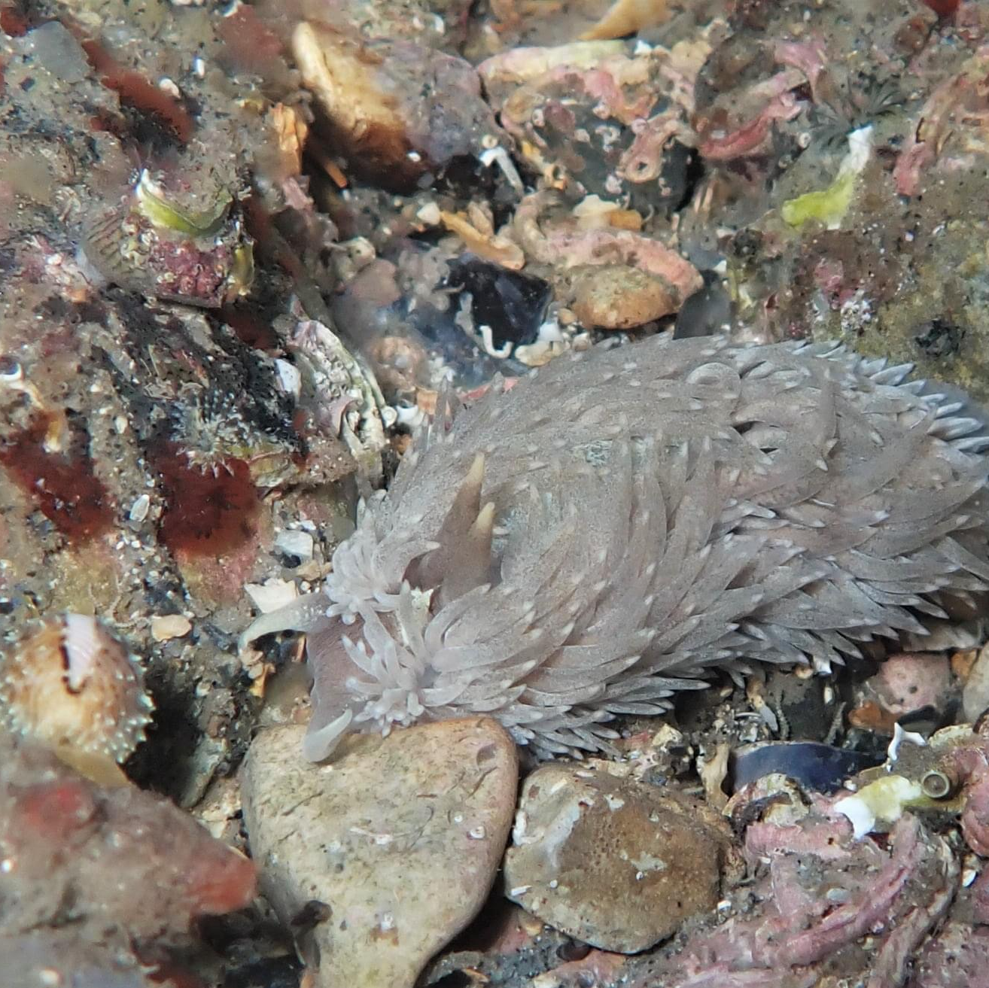
Gallery

Slide 5
Information recording.
The project is registered as a club conservation project on the BSAC website.
Background information on the site and the Fleet.
Simple plans of the dive site.
A computer file to store material some of which will be written up as a blog on the NDSAC website.
A species list is being developed.
A project gallery will be on the NDSAC web site.
Please remember PLAN the DIVE. Although a shallow dive, the site is subject to variable conditions and slacks. The Fleet is a SSSI.

